Slide 1

Python Programming Foundational level
Prepared by Isaac Kamau
+254757640352 | +254707661262 E - denacoent@gmail.com

Slide 2
In this session, we are shall be covering:
Python Programming Basics
Python language advantages and applications.
Download and Install Python IDE
Use and Installation of Jupyter Notebook as a Python platform.

Slide 3
What is python?
Python is a popular programming language. It was created by guido van rossum, and released in 1991.
What can python do?
Python can be used on a server to create web applications.
Python can be used alongside software to create workflows.
Python can connect to database systems. It can also read and modify files.
Python can be used to handle big data and perform complex mathematics.
Python can be used for rapid prototyping, or for production-ready software development.

Slide 4
Why Python?
Python works on different platforms (windows, mac, linux, raspberry pi, etc).
Python has a simple syntax similar to the english language.
Python has a syntax that allows developers to write programs with fewer lines than some other programming languages.
Python runs on an interpreter system, meaning that code can be executed as soon as it is written. This means that prototyping can be very quick.
Python can be treated in a procedural way, an object-oriented way or a functional way.
Good to know
The most recent major version of python is python 3, which we shall be using. However, python 2, although not being updated with anything other than security updates, is still quite popular. It is possible to write python in an integrated development environment, such as thonny, pycharm, netbeans or eclipse which are particularly useful when managing larger collections of python files. In our case we will be using pycharm and anaconda as our IDE

Slide 5
Python Install
Many PCs and Macs will have python already installed.
To check if you have python installed on a Windows PC, search in the start bar for Python or run the following on the Command Line (cmd.exe):
C:\Users\Your Name>python --version
To check if you have python installed on a Linux or Mac, then on Linux open the command line or on Mac open the Terminal and type:
python --version
If you find that you do not have Python installed on your computer, then you can download it for free from the following website: https://www.python.org/

Slide 6
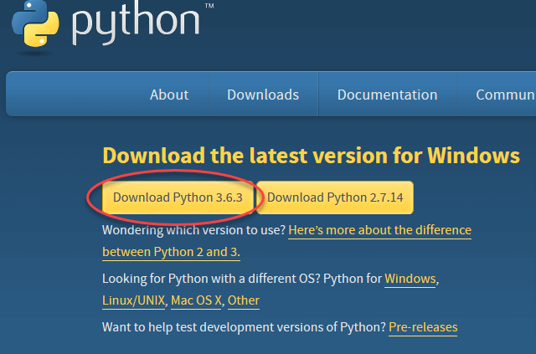
Install Python
To download and install Python, visit the official website of Python https://www.python.org/downloads/ and choose your version. We will be using Python Version 3.11.2 but for demonstration purposes, We have used Python version 3.6.3

Slide 7
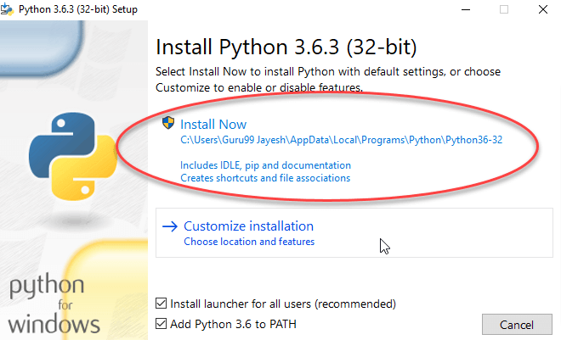
2. Once the download is completed, run the .exe file to install Python. Now click on Install Now.

Slide 8
Python Integrated development environment // IDE: (Pycharm, Juypter Notebook, IDLE, CMD)

Slide 9
Python IDLE
What Is Python IDLE?
Every Python installation comes with an Integrated Development and Learning Environment, which you’ll see shortened to IDLE or even IDE. These are a class of applications that help you write code more efficiently. While there are many IDEs for you to choose from, Python IDLE is very bare-bones, which makes it the perfect tool for a beginning programmer.
Python IDLE comes included in Python installations on Windows and Mac. If you’re a Linux user, then you should be able to find and download Python IDLE using your package manager. Once you’ve installed it, you can then use Python IDLE as an interactive interpreter or as a file editor.

Slide 10
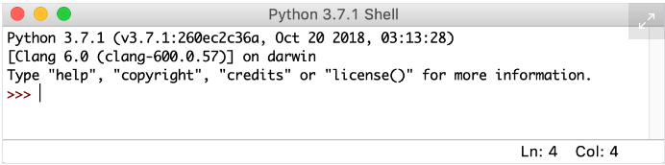
How to Use the Python IDLE Shell:
The shell is the default mode of operation for Python IDLE. When you click on the icon to open the program, the shell is the first thing that you see

Slide 11
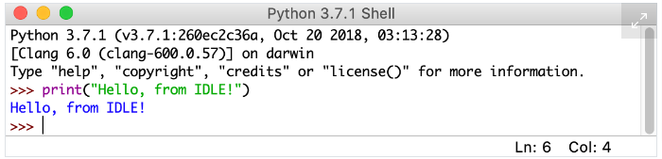
This is a blank Python interpreter window. You can use it to start interacting with Python immediately. You can test it out with a short line of code as follows

Slide 12
3. Install PyCharm:
PyCharm is a cross-platform editor developed by JetBrains. Pycharm provides all the tools you need for productive Python development.
Check System requirements here: https://www.jetbrains.com/help/pycharm/installation-guide.html#requirements
For Windows follow this link: https://www.jetbrains.com/pycharm/download/#section=windows
For MacOS follow this link: https://www.jetbrains.com/pycharm/download/#section=mac
For Linux OS follow this link: https://www.jetbrains.com/pycharm/download/#section=linux
Once the download is complete, run the exe for install PyCharm. The setup wizard should have started. Click “Next”.

Slide 13
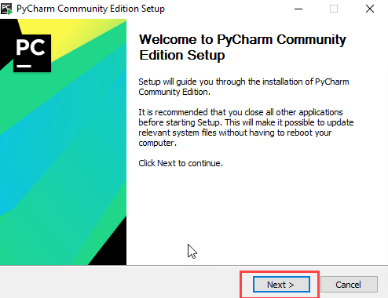

Slide 14
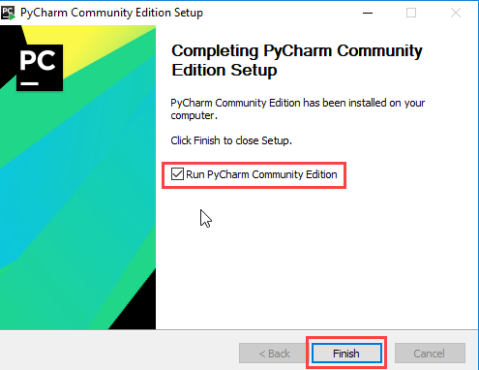
Proceed with the DEFAULT installation. Once installation finished, you should receive a message screen that PyCharm is installed. If you want to go ahead and run it, click the “Run PyCharm Community Edition” box first and click “Finish”.

Slide 15
Create your First Python Program
To create a new project, click on “Create New Project”. On the introductory screen of the Pycharm
You will need to select a location.
You can select the location where you want the project to be created. If you don’t want to change location than keep it as it is but at least change the name from “untitled” to something more meaningful, like “FirstProject”.
PyCharm should have found the Python interpreter you installed earlier.
Next Click the “Create” Button.

Slide 16
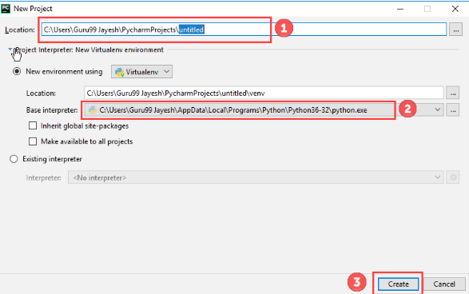

Slide 17
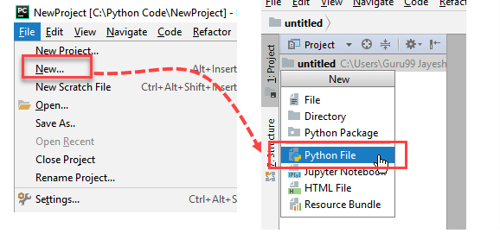

Slide 18
A new pop-up will appear. Now type the name of the file you want (Here we give “HelloWorld”) and hit “OK”.
Now go to the “Run” menu and select “Run” to run your program.

Slide 19
Anaconda
Anaconda is a program to manage (install, upgrade, or uninstall) packages and environments to use with Python. It's simple to install packages with Anaconda and create virtual environments to work on multiple projects conveniently.
Even if you already have Python installed, it will be beneficial to use Anaconda/Miniconda because:
Anaconda comes with a bunch of data science packages; you'll be all set to start working with data.
Using conda to manage your packages and environments will reduce future issues dealing with the various libraries you'll be using.
Anaconda is a software distribution that includes the following:
Anaconda Navigator - It is a graphical user interface that helps open up any installed applications, such as Jupyter notebook or VS code editor. We will learn more about the notebook in the next lesson. See a snapshot of Anaconda Navigator below:

Slide 20
Installing Anaconda:
For Windows follow this link https://docs.anaconda.com/anaconda/install/windows/
For MacOS follow this link https://docs.anaconda.com/anaconda/install/mac-os/
For Linux OS follow this link https://docs.anaconda.com/anaconda/install/linux/
Download the Anaconda installer.
Go to your Downloads folder and double-click the installer to launch. To prevent permission errors, do not launch the installer from the Favorites folder.
Note,If you encounter issues during installation, temporarily disable your anti-virus software during install, then re-enable it after the installation concludes. If you installed for all users, uninstall Anaconda and re-install it for your user only.
Click Next.
Read the licensing terms and click I Agree.
It is recommended that you install for Just Me, which will install Anaconda Distribution to just the current user account. Only select an install for All Users if you need to install for all users’ accounts on the computer (which requires Windows Administrator privileges).
Click Next.
Select a destination folder to install Anaconda and click Next. Install Anaconda to a directory path that does not contain spaces or unicode characters. For more information on destination folders, see the FAQ.

Slide 21
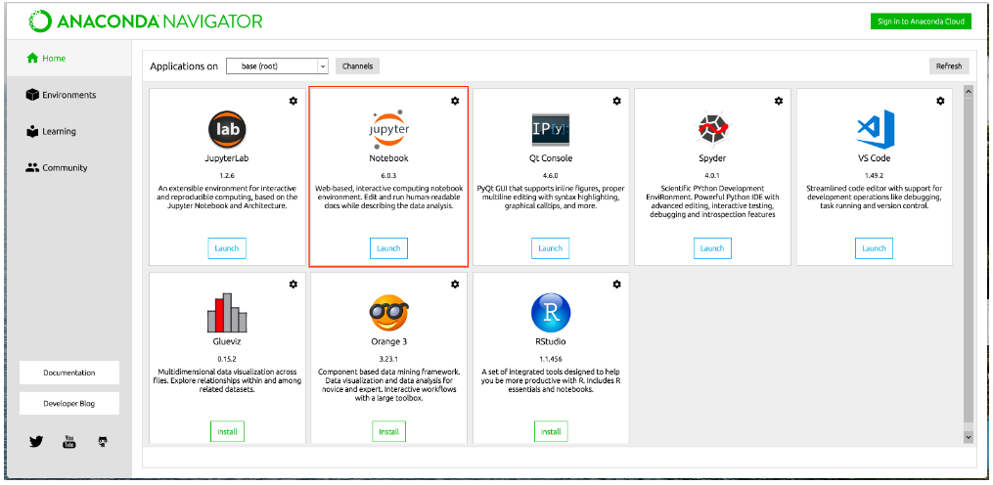

Slide 22
The Python Command Line
if you don’t have Pycharm Editor/Jupyter installed, you can still run the code from the command prompt. Enter the correct path of a file in the command prompt to run the program.

Slide 23
Windows CMD Command
What Is CMD
CMD stands for Command (.CMD). A command is an instruction given to a computer program that tells the program what has to be done. It is an application that is found in most computers with Windows as the Operating System, and it helps in the execution of the commands entered. It is also called Command Prompt or Windows Command Processor.
Why Is Command Prompt Useful
Command prompt has become increasingly popular with people having no background in IT as it helps to automate several tedious, mundane tasks with the help of a few clicks. The interface allows the user to run multiple commands, and the commands can be executed one after the other. This has proved a boon in the world of automation.
Most users find it difficult to learn and cannot use Command prompt as compared to the user-friendly interface that is available on the modern apps, however, Command prompt can still be used in many situations.

